Slide 1

Spatial data and analysis in R
ESM – internal course series
(Artwork by @allison_horst)
Martin Jung, PhD (jung@iiasa.ac.at)

Slide 2
Course plan
Introduction talk
(14:00 – 14:45pm, 22th October 2020)
Self study tutorials
(online self paced, link at end of slides)
All slides and materials online
https://tinyurl.com/TrainSpatR

Slide 3







What is GIS?
A geographic information system (GIS) is a system designed to capture, store, manipulate, analyze, manage, and present types of geographical data.

Slide 4
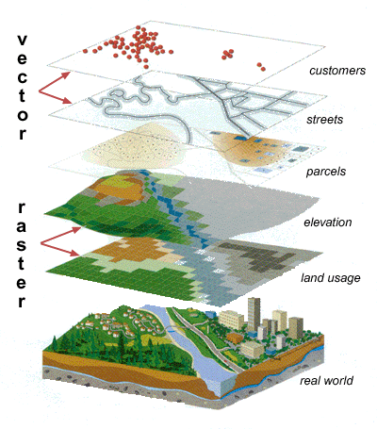
Types of spatial data
Format:
*.shp, *.gpkg, *.gpx, *.kml, ...
Format:
*.tif, *.vrt, *.hdr, *.asc, ...
Source: maprabu.blogspot.com

Slide 5
Vector
Advantage: Accuracy, more visually pleasing
Disadvantage: Space-inefficient. Every vertex needs to be stored. Algorithms computational intensive.
Raster
Advantage: Geogr. Position associated with data, easier for analysis
Disadvantage: Resolution dependent on cell-size. Lack of attributes, MAUP
Notes:
Google, Bing, Openstreetmaps, ... ( OpenLayers plugin)
WMS server, for instance the EEA WMS services
http://discomap.eea.europa.eu/home.html
Can be loaded into QGIS as WMS layer

Slide 6






Spatial databases
SpatiaLite
PostgreSQL & PostGIS
And many more…

Slide 7


Stop using shapefiles!
Multifile system (.shp,.shx,.dbf,.prj, … )
Limited to 2GB (4GB)
Attribute names limitation
Etc...
http://switchfromshapefile.org/
Solution → OGC Geopackages

Slide 8
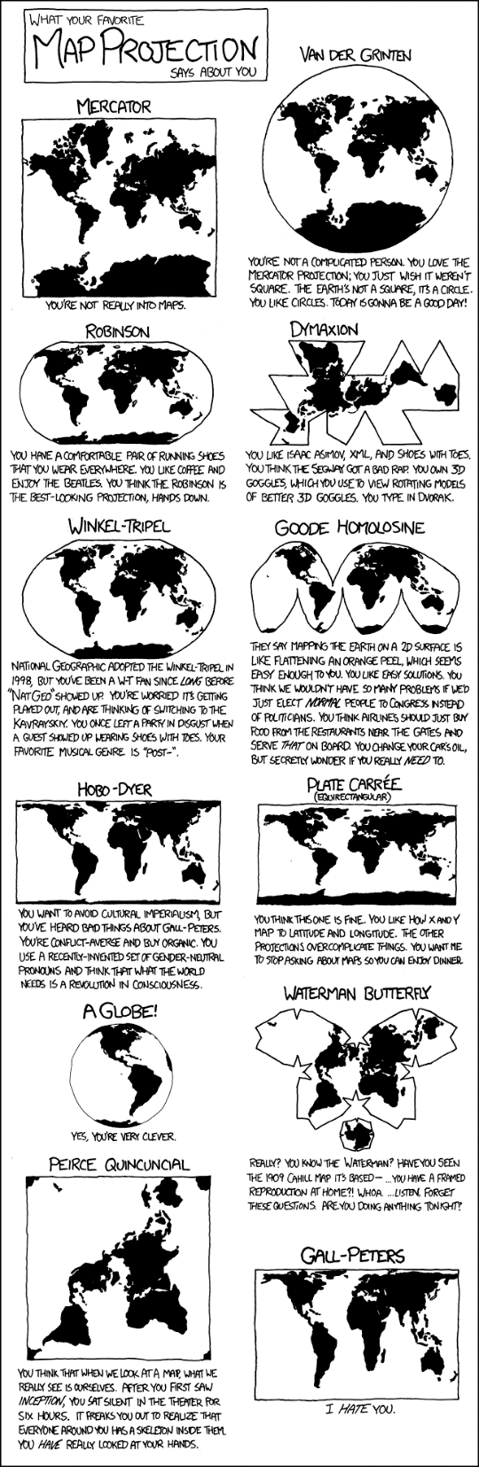
Geographic projections
Spatial data requires a projection
Choosing an appropriate geographic projection is important
Meter or degree based?
Tradeoff between shape, area or distance distortion
Aesthetics vs accuracy
Source: https://xkcd.com/977/

Slide 9
Why use R for spatial analyses?
Open source
Efficiency (‘Don’t repeat yourself’)
Cross system availability (Win,*Nix, MacO$
Extendable and rich functionality
Clean coding (also for ‘tidy’ data concept)
Parallel computing support
Integration of C, C++ code for speed

Slide 10

Many spatial packages
Source: https://doi.org/10.1016/j.envsoft.2020.104799

Slide 11
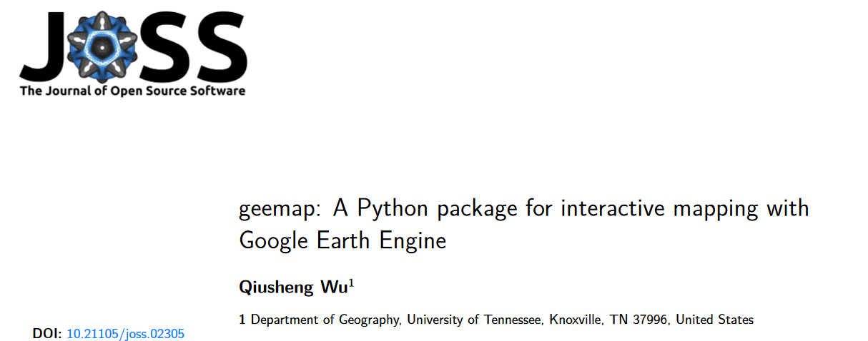

Slide 12
One comprehensive list of spatial packages
https://cran.r-project.org/web/views/Spatial.html

Slide 13
Why/When not to use R for spatial analyses?
R can be slow
Many (sp) packages not memory efficient
Often little support
No GUI
Greater proficiency in other languages

Slide 14
(Personal opinion)
The diversity of open source GIS solutions is both its greatest strength and weakness

Slide 15
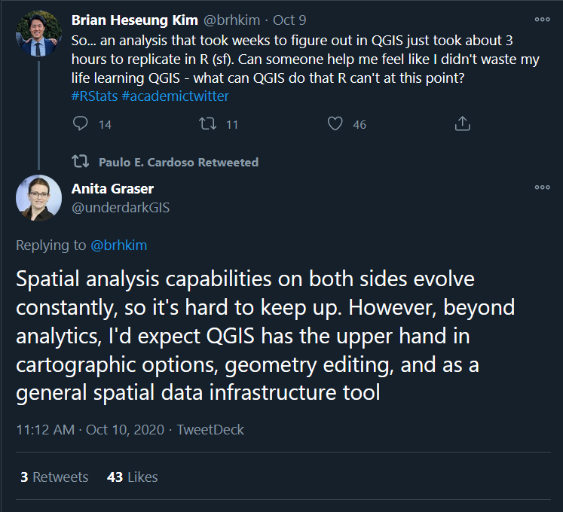

Slide 16




The backbone of most open-source GIS
Standards like WMS, KML, GML, SFC
C/C++ libraries

Slide 17
R as a GIS
Main packages: ‘sp’, ‘raster’ and ‘rgdal’ still go-to functions to use
Problem: Each have their own object-based model, often inefficient code

Slide 18

Artwork by @allison_horst

Slide 19

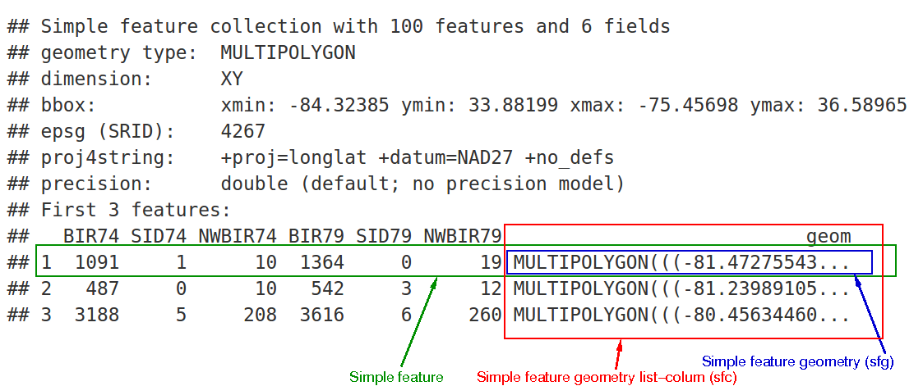
Tidy data and simple features
Simple Features are a set of OGC standards how spatial (vector) data is to be stored
Source: https://r-spatial.github.io/sf/articles/sf1.html

Slide 20

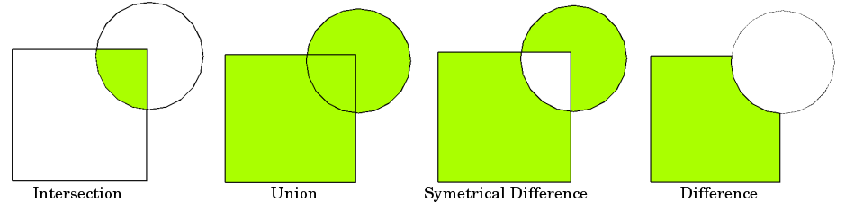
Spatial analyses – vector data
Spatial selections
Buffering
Source: QGIS documentation

Slide 21
Example code in R using ‘sf ‘
World %>%
st_transform(crs = 54009) %>%
st_buffer(1000) %>%
st_intersects(hotspots) %>%
group_by(hotspot_name) %>%
summarise(
geometry = st_union(geometry),
area = st_area(geometry)
)

Slide 22
Spatial analyses – raster data
Examples
Aggregations, disaggregations
Region growth, reclassifications
Band arithmetic (NDVI etc)
Terrain analyses (Slope, Aspect, Curvature)
…

Slide 23
Common spatial tasks I do in R
Aligning raster input data
Extracting zonal statistics
Joining spatial and non-spatial
data

Slide 24
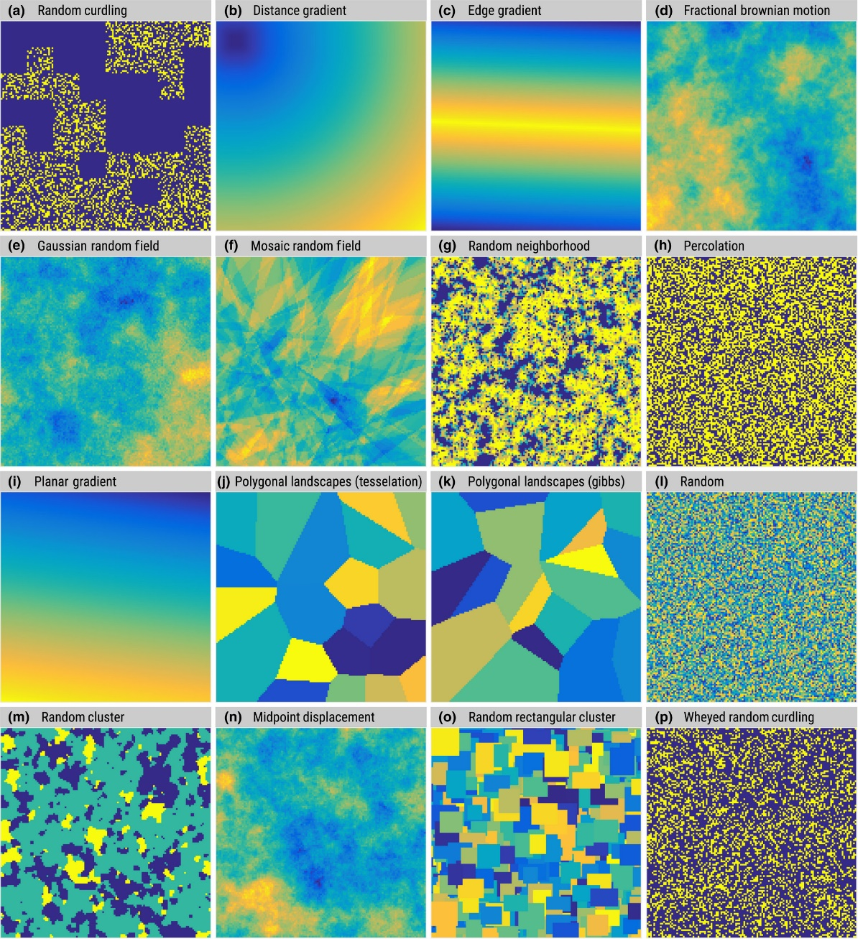
Examples: Neutral landscapes
Source:
https://ropensci.github.io/NLMR/

Slide 25
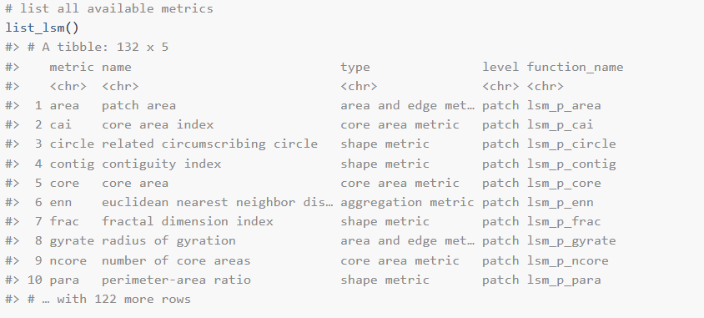
Example: Landscape metrics
Source:
https://r-spatialecology.github.io/landscapemetrics/

Slide 26
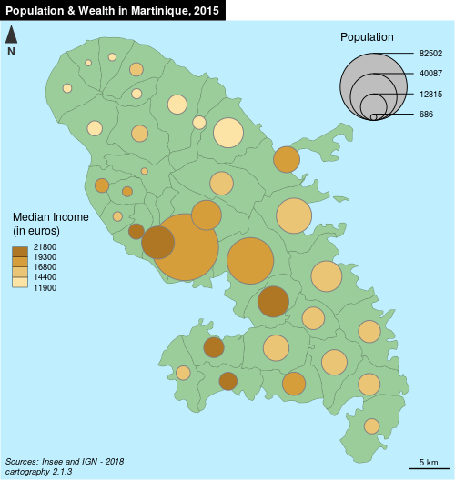
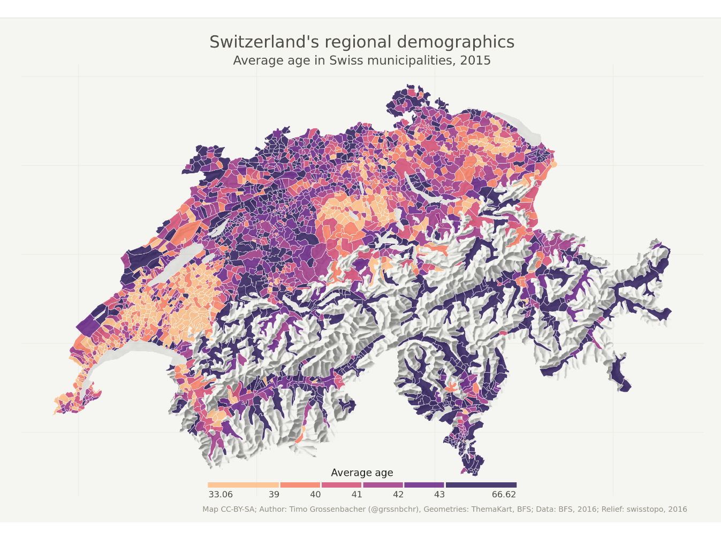
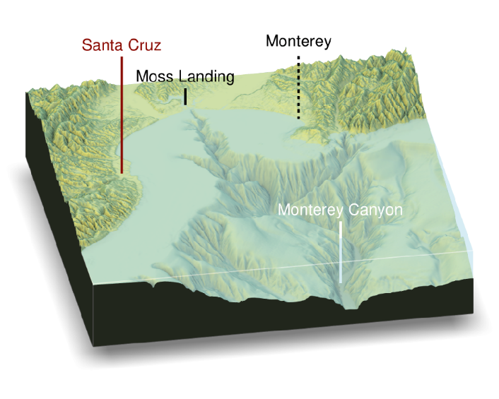
Making maps in R
Source: http://riatelab.github.io/cartography
Source: https://timogrossenbacher.ch/2016/12/beautiful-thematic-maps-with-ggplot2-only/
Source: https://github.com/tylermorganwall/rayshader

Slide 27
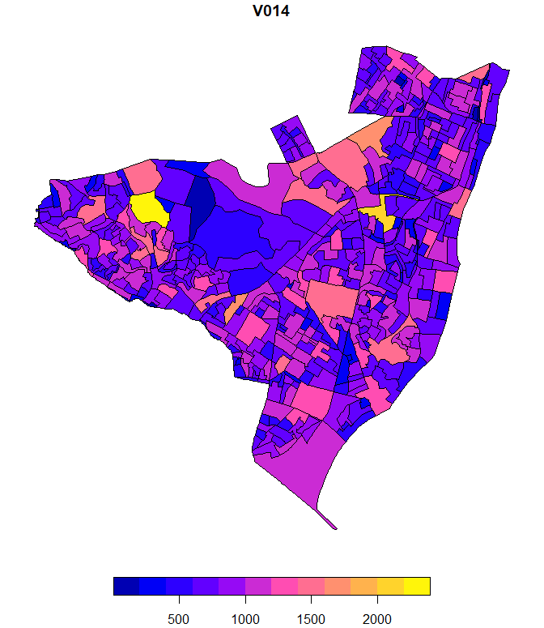
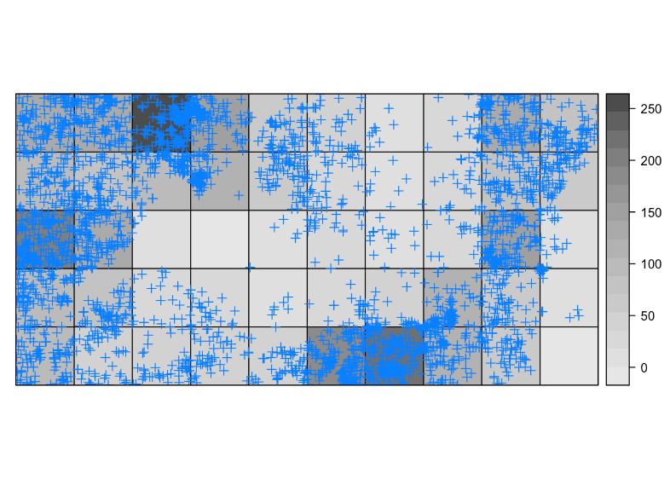
Spatial statistics
(Not covered in the online course!)
Geographically weighted regressions, Kriging, Network analyses, Spatial clustering, Machine learning
…
A lot of data has spatial structure!

Slide 28

What to do if things don’t work
Too slow
→ Check memory requirements, consider tiling
No Function
→ Check external tools. Is there a wrapper?
Visualization
→ Use QGIS for quick queries

Slide 29
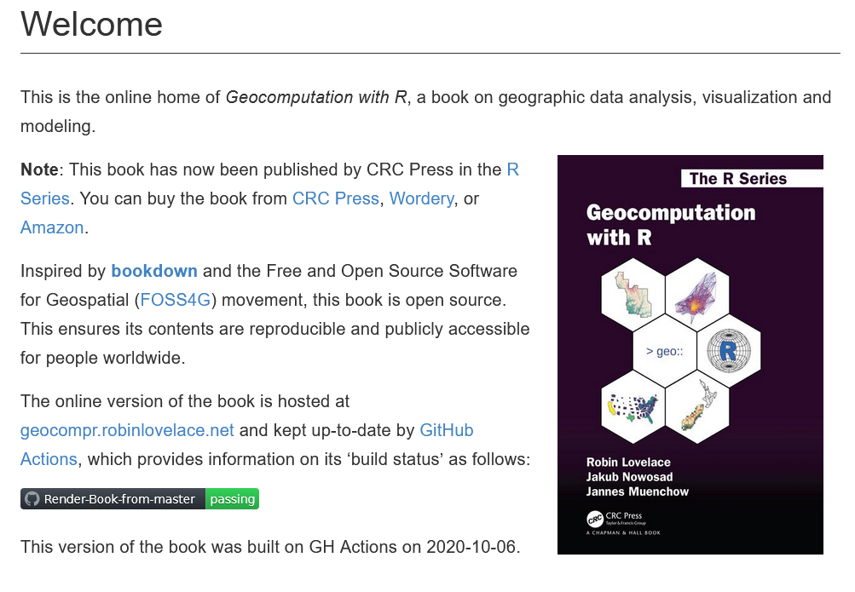
Free online books and materials
https://geocompr.robinlovelace.net/index.html

Slide 30
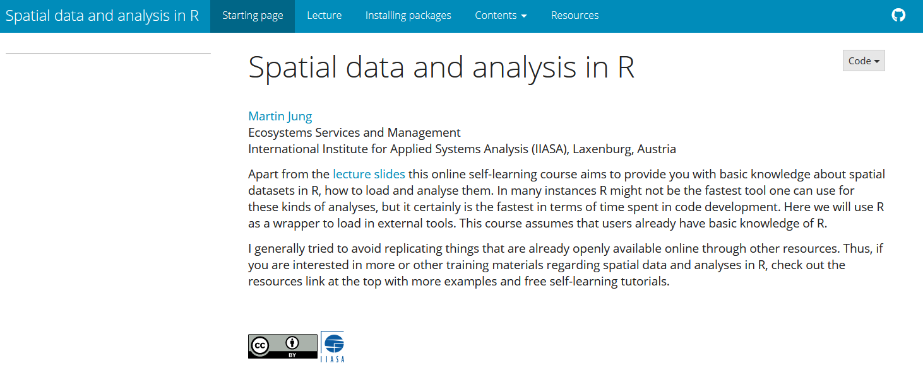
Online course materials
https://tinyurl.com/TrainSpatR
Notes:
Not covered: Spatial analyses in form of statistics…

Slide 31
Thank you for your attention. Good success with your spatial analyses!

